Slide 1
The Great Smoky Mountains
Fly fishing America’s most visited National Park

Slide 2
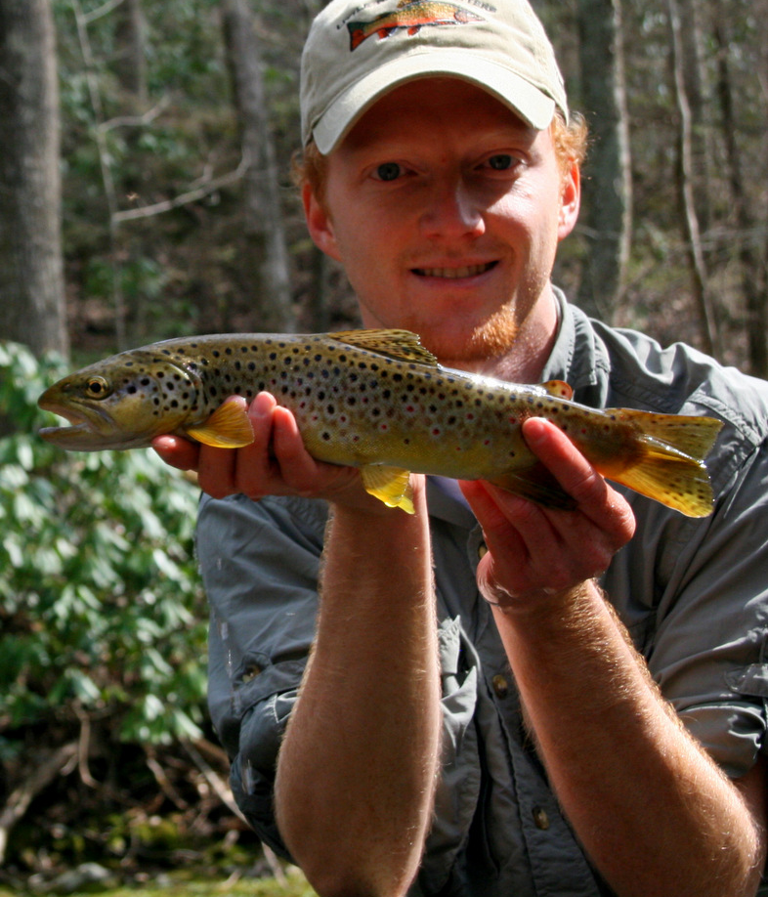
About Me
My name is David Knapp. I’ve been fly fishing for close to 20 years and have fished Arizona, Colorado, Wyoming, Montana, South Dakota, and Utah as well as lots of great waters much closer to home here in Tennessee, Kentucky, and North Carolina.
I started guiding this past year. You can read about my most recent adventures at thetroutzone.blogspot.com or learn more about guided trips at TroutZoneAnglers.com.

Slide 3
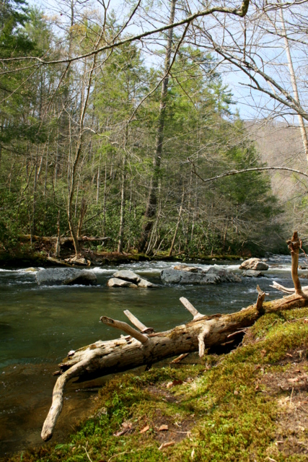
Overview
The Streams and Quarry
The Seasons
The Hatches
Tips for Success

Slide 4
The Streams and Quarry
What is the most common catch in the majority of Smoky Mountain streams?
Rainbow, brown, and brook trout make up the majority of most anglers catches.
Streams to fit just about any type of fishing you want to do including some smallmouth bass water.

Slide 5
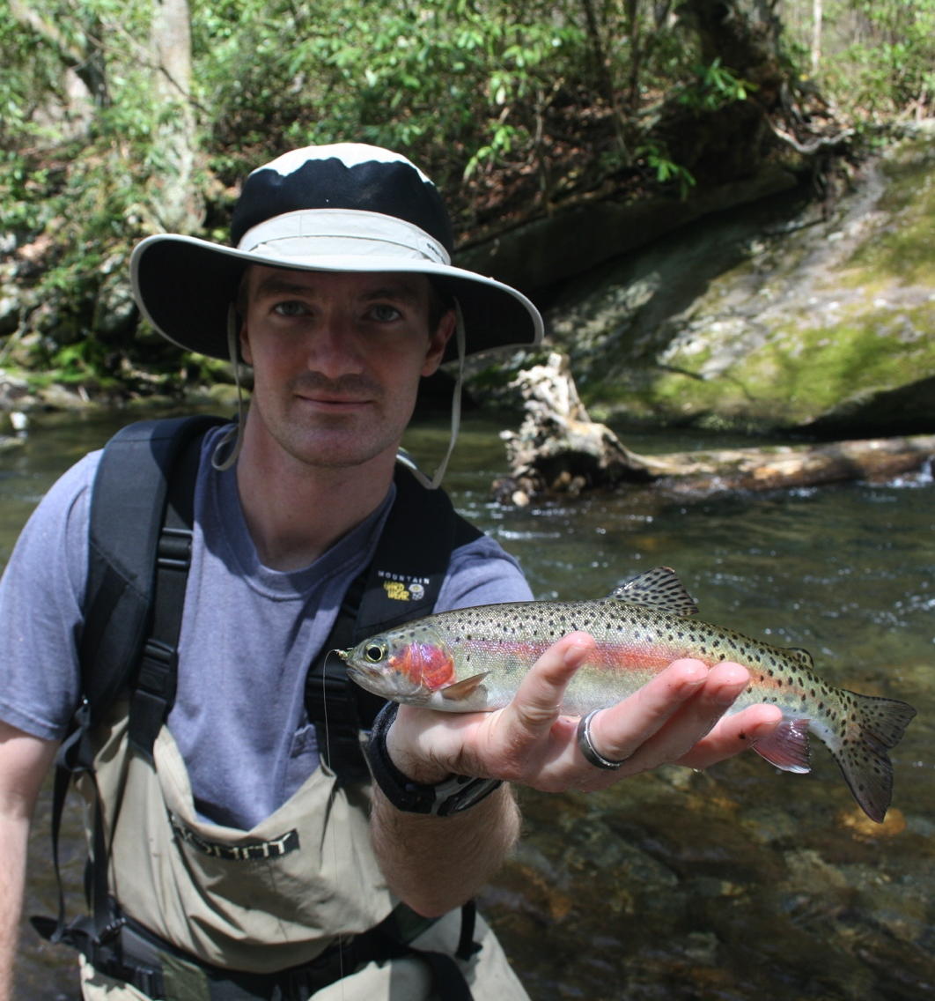
Streams: Tennessee
Abrams Creek, Little River drainage, Little Pigeon drainage, Indian Camp Creek, Cosby Creek

Slide 6
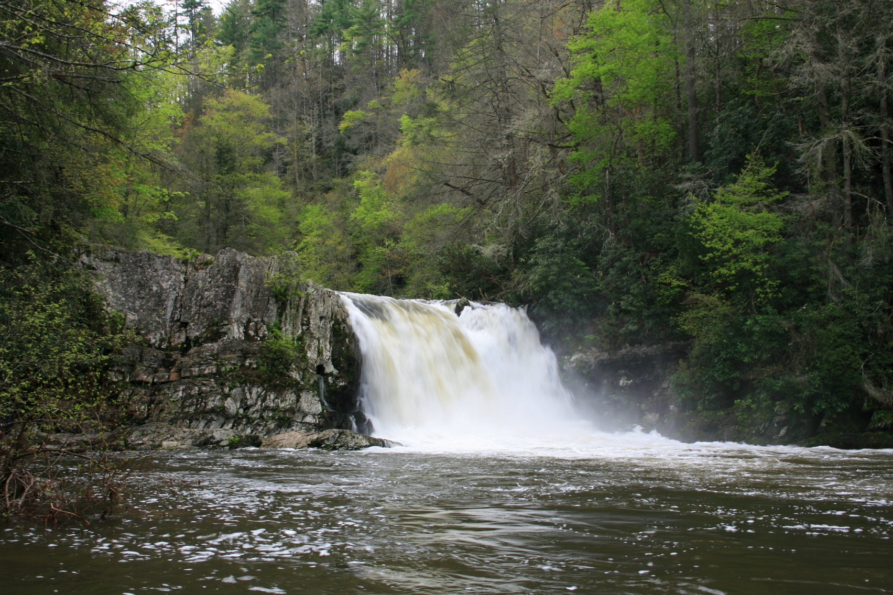
Streams: Tennessee
Abrams Creek, primarily a rainbow trout fishery, is a limestone spring creek which makes it much more fertile than other Park waters. It boasts the best hatches including the famed but hard to hit Green Drake hatch. Evening spinner falls can be particularly impressive on this stream. Below Abrams Falls, the stream gradually transitions to good smallmouth bass water.

Slide 7
Streams: Tennessee
Little River drainage including the West, Middle, and East Prongs contain good populations of rainbow trout. The Middle and East Prongs also have brown trout with the best numbers in the East Prong, usually just referred to as Little River.
If you want to catch brookies on Little River, you need to hike at least 5 miles above Elkmont to start seeing a few and further to find good numbers. Lynn Camp Prong, a tributary stream of Middle Prong, is open after being closed for restoration for several years and provides an excellent mid elevation brook trout fishery relatively close to Townsend.

Slide 8
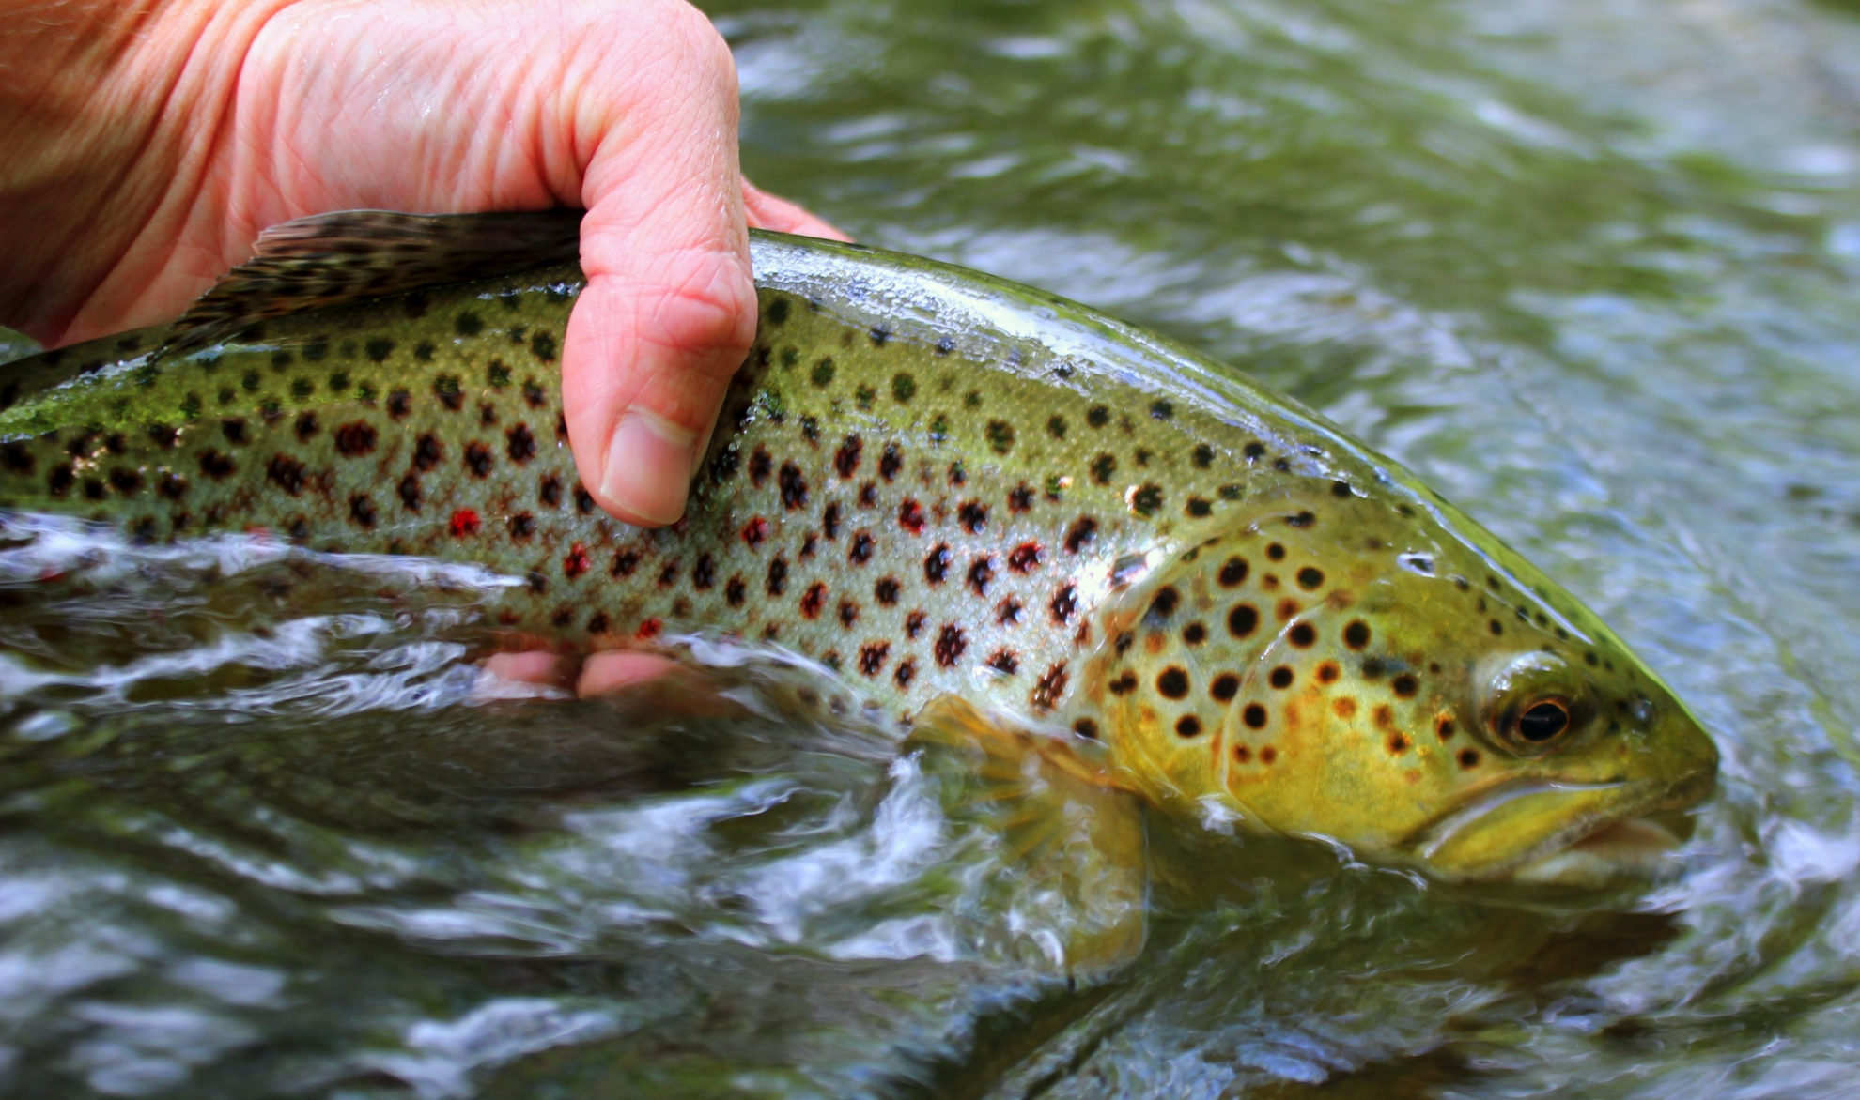
Streams: Tennessee

Slide 9
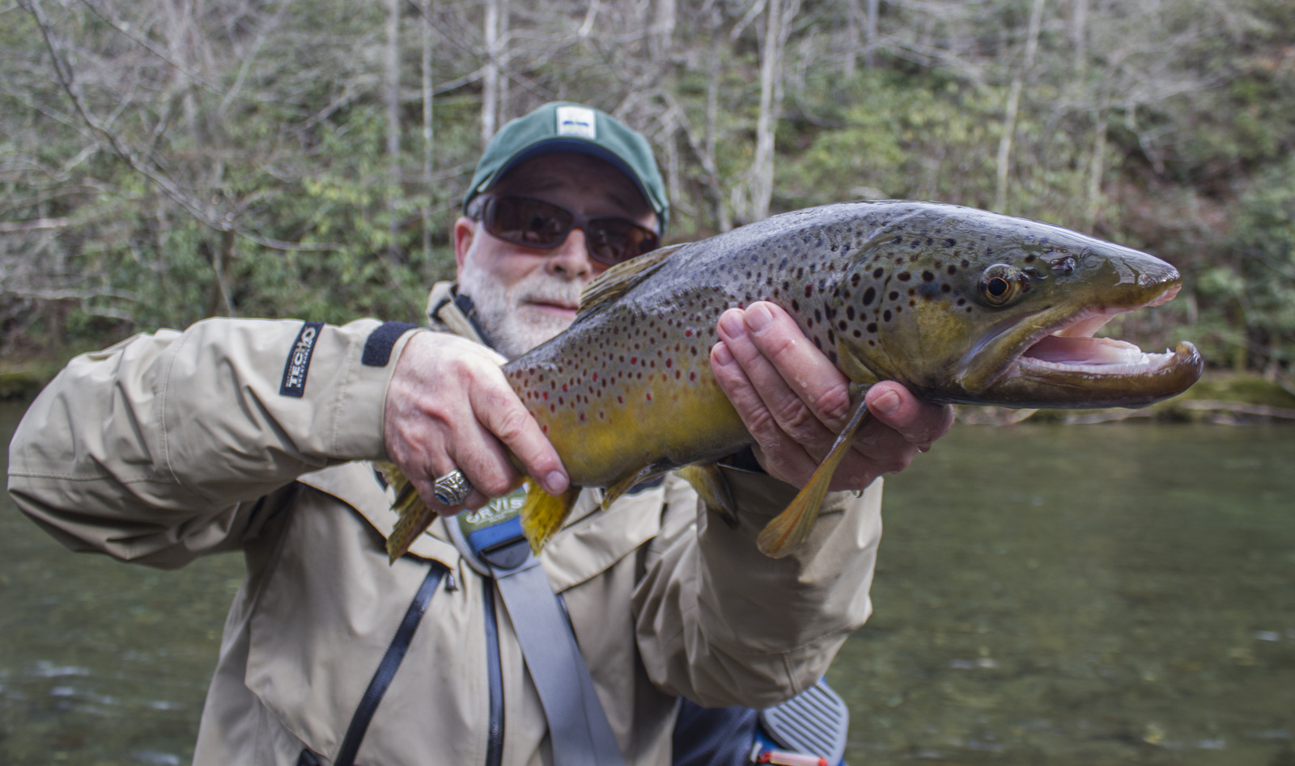
Streams: Tennessee

Slide 10
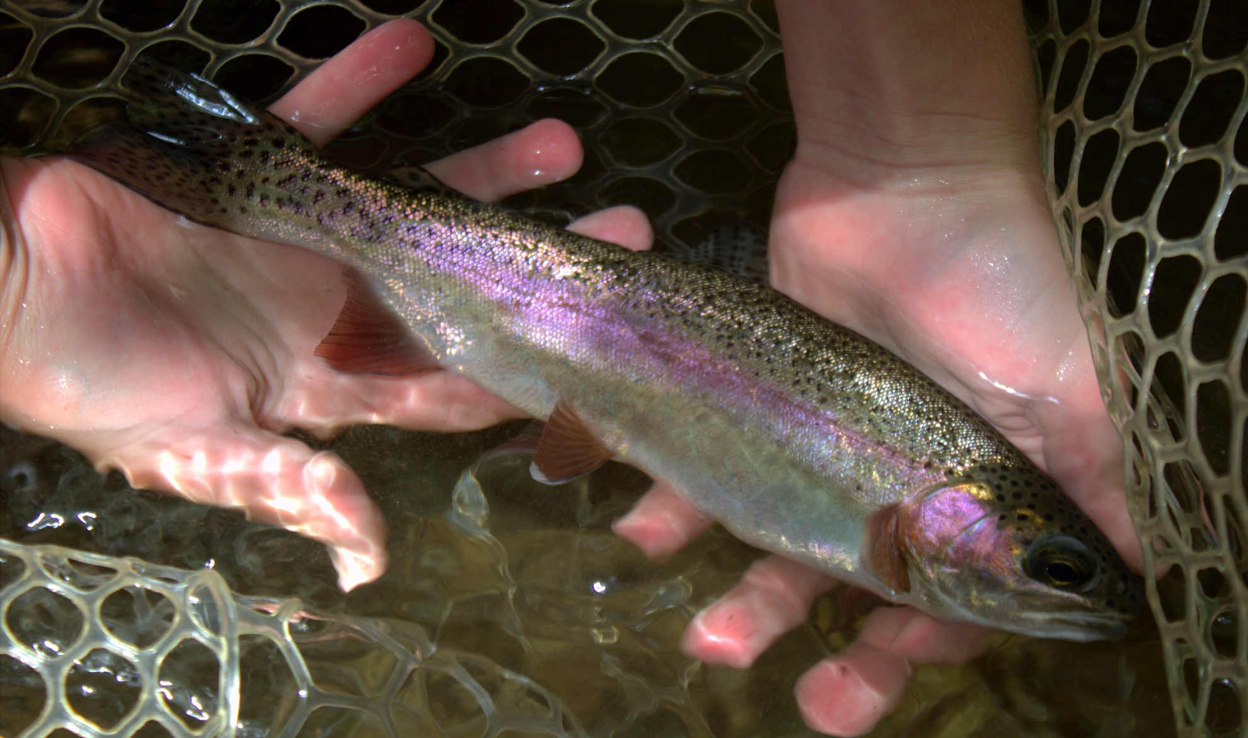
Streams: Tennessee

Slide 11
Streams: Tennessee
The Little Pigeon drainage includes the West and Middle Prongs of the Little Pigeon. Both are relatively close to Gatlinburg making them popular with tourists staying there. Both the West and Middle Prongs offer decent to good brook trout fishing although the fish in the West Prong are not genetically pure Southern strain brookies.
Higher gradient water compared to Little River and Abrams Creek makes for some easier catching but possibly harder fishing.
The West Prong of the Little Pigeon was one of the few streams impacted by the Chimney Tops 2 (Gatlinburg) fire. The good news is that it does not seem to have suffered much as a fishery.

Slide 12
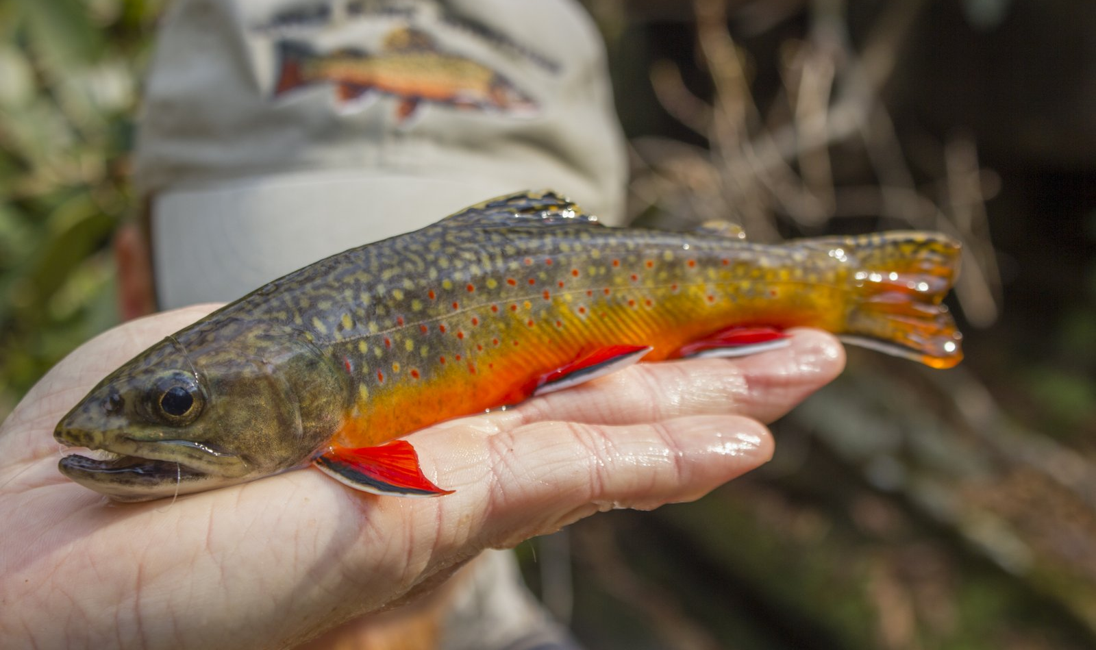
Streams: Tennessee

Slide 13
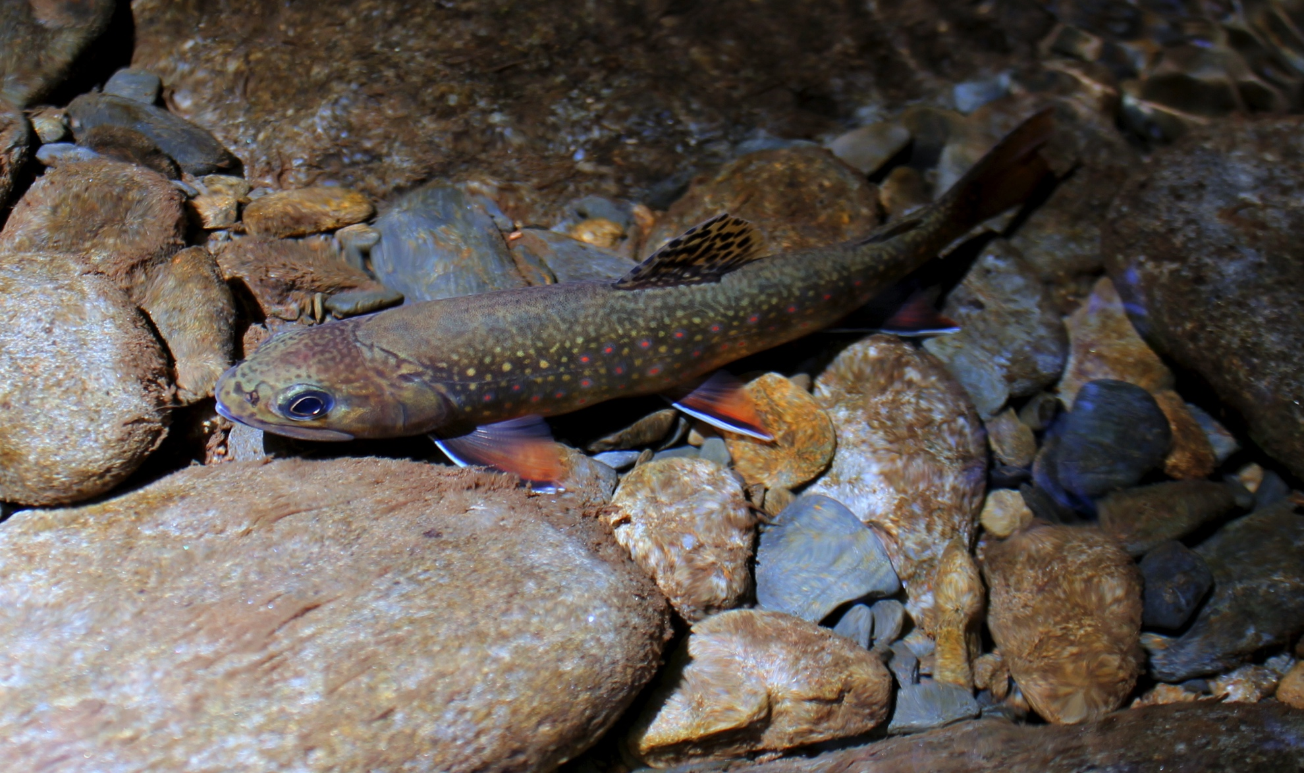
Streams: Tennessee

Slide 14
Streams: Tennessee
Cosby Creek is one of the better brook trout fisheries in the Park but sees surprisingly light fishing pressure compared to streams further west. Part of this is the more remote nature of the Cosby area as well as the fact that there is a lot of great water closer to destinations like Gatlinburg and Townsend. The past couple of years have been tougher due to a severe flash flood.

Slide 15
Streams: North Carolina
Fontana Lake Tributaries include, Eagle, Hazel, Forney, and Noland Creeks. Upstream tributaries to the same system include Deep Creek and the Oconaluftee system. In the forgotten east and northeast side of the Park, Big Creek and Cataloochee Creek (and its tributaries) offer some of the least pressured fishing in the Park.

Slide 16
Streams: North Carolina
Fontana Lake tributaries all contain good populations of rainbow and brown trout. Most of them also have brook trout populations if you go upstream far enough above the lake. Hazel Creek is one of the most famous streams in the whole Park and everyone owes it to themselves to fish it at least once in their life for the historic significance as well as the excellent fishing and backcountry experience. Of all the Fontana Lake tributaries, Forney is probably the most overlooked and worth the effort it takes to explore it.

Slide 17
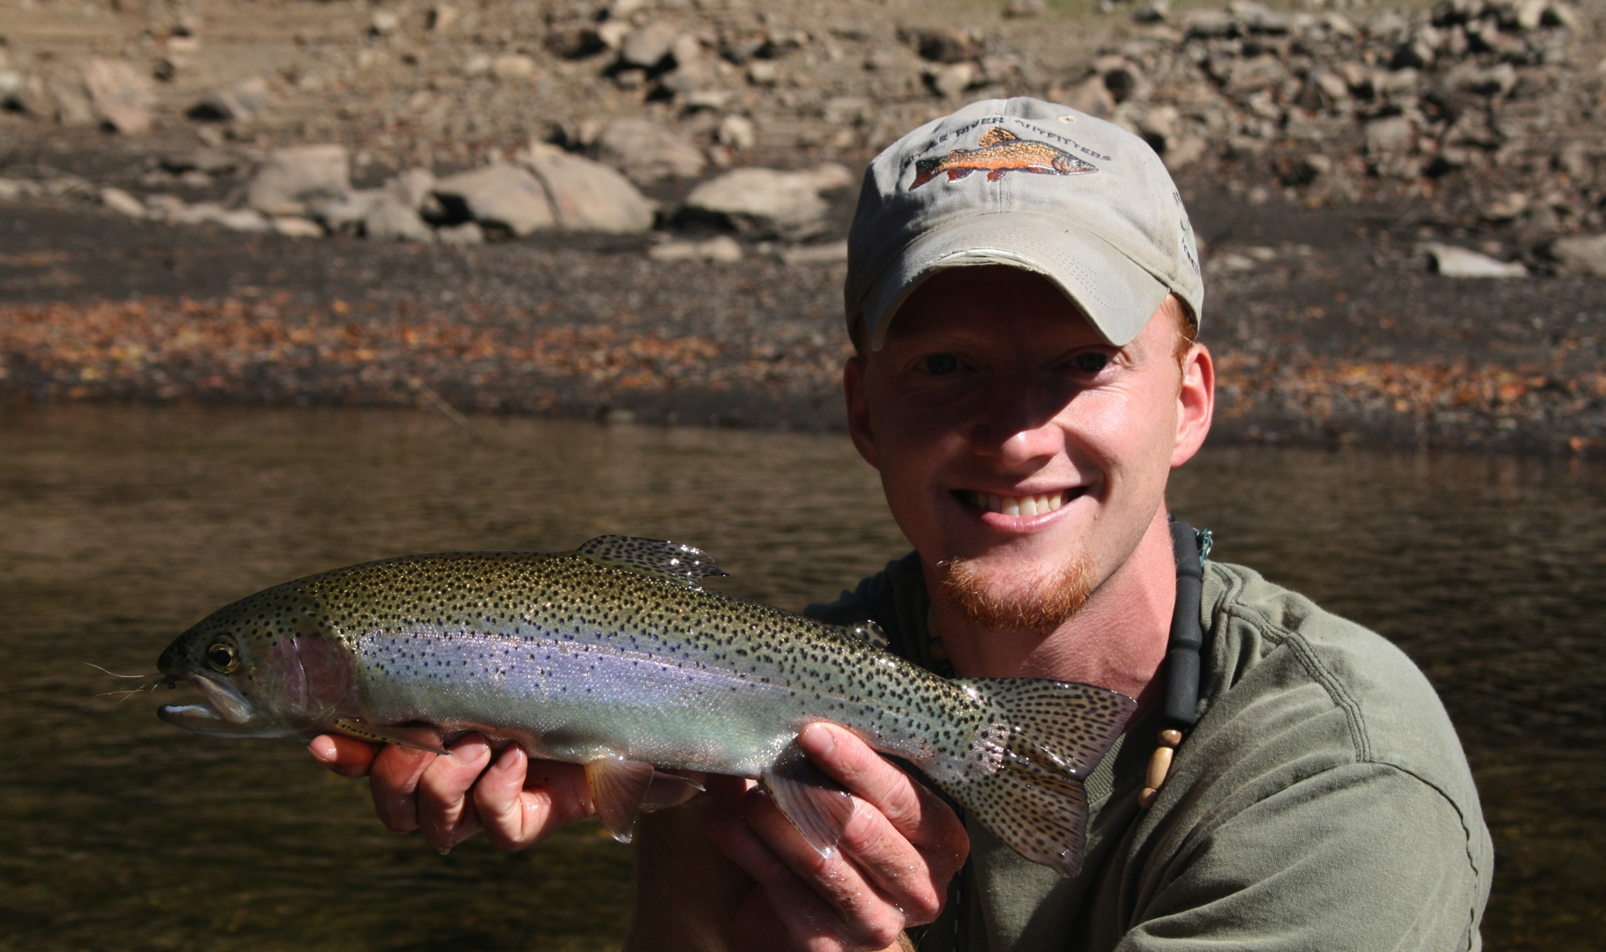
Streams: North Carolina

Slide 18
Streams: North Carolina
Deep Creek is one of my personal favorites, perhaps because I always seem to have a good day when I fish it. Known for the brown trout fishing, Deep Creek also has brook trout in the headwaters making it a good option to try and accomplish the Park slam. The only downside to Deep Creek is that most fishing on the stream requires walking to access the water.

Slide 19
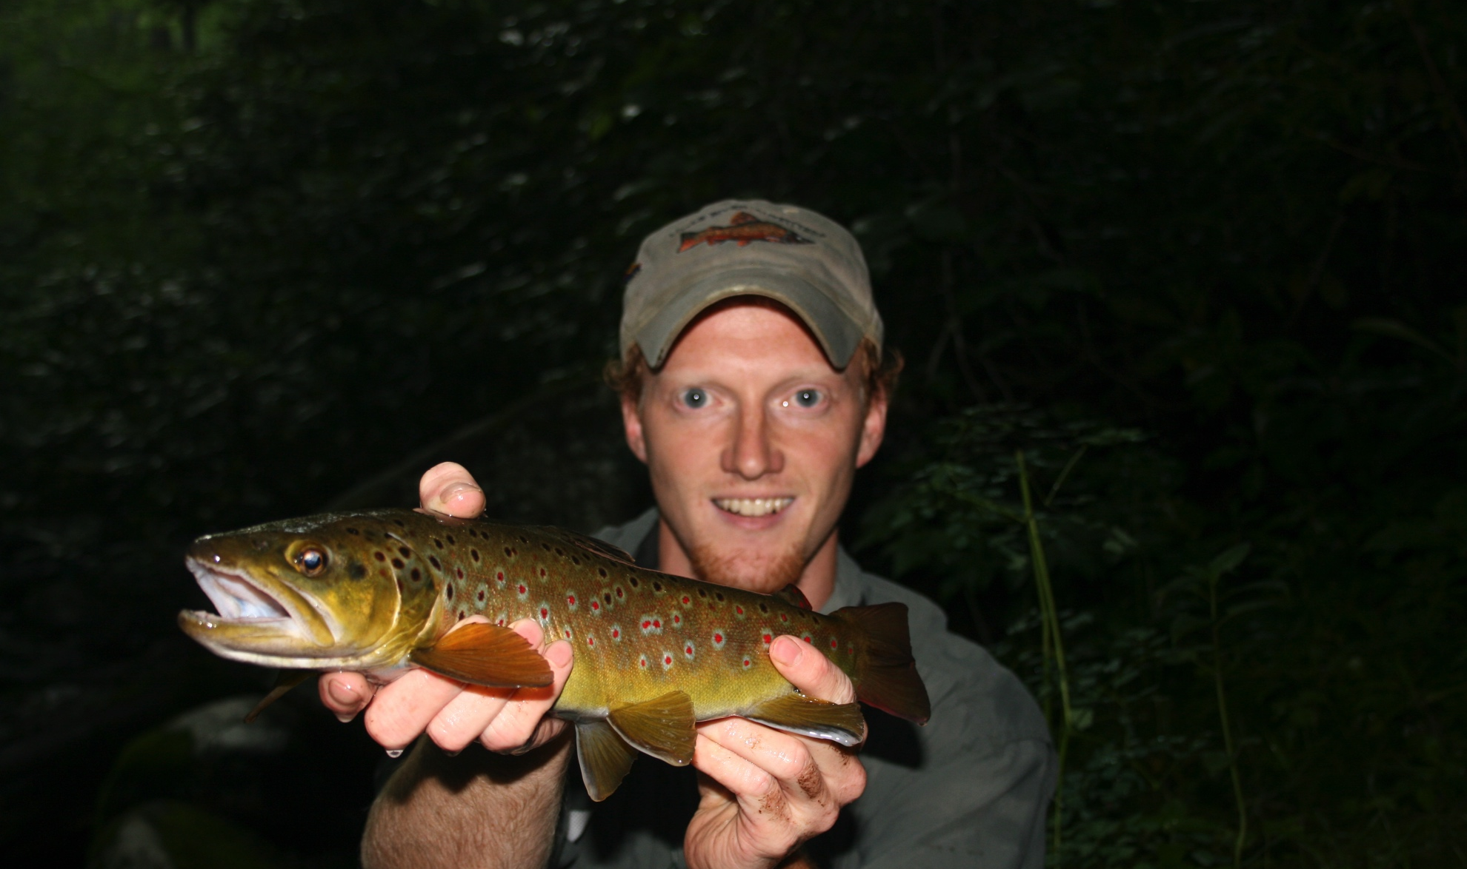
Streams: North Carolina

Slide 20
Streams: North Carolina
The Oconaluftee River system includes the ‘Luftee and its tributaries such as Bradley Fork, Raven Fork, and Straight Fork. Both Raven Fork and Straight Fork offers good fishing as they flow through the Cherokee lands outside the Park. Straight Fork has great fishing in the Park along a gravel road while Raven Fork requires a fairly short but intense hike to reach. It flows through a rugged gorge and should only be fished with a buddy for safety. The Oconaluftee and Bradley Fork are both excellent brown trout streams along with the usual rainbows. Brook trout can be found in the headwaters of all these streams.

Slide 21
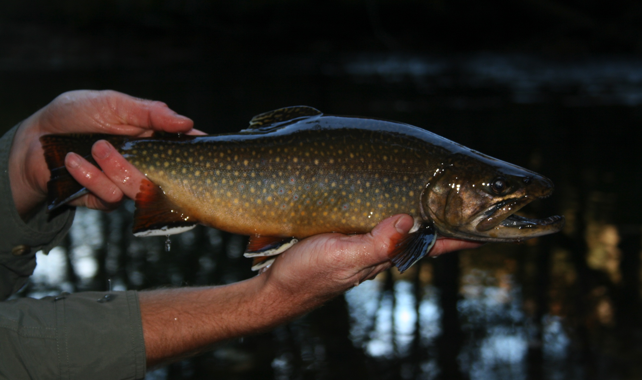
Streams: North Carolina

Slide 22
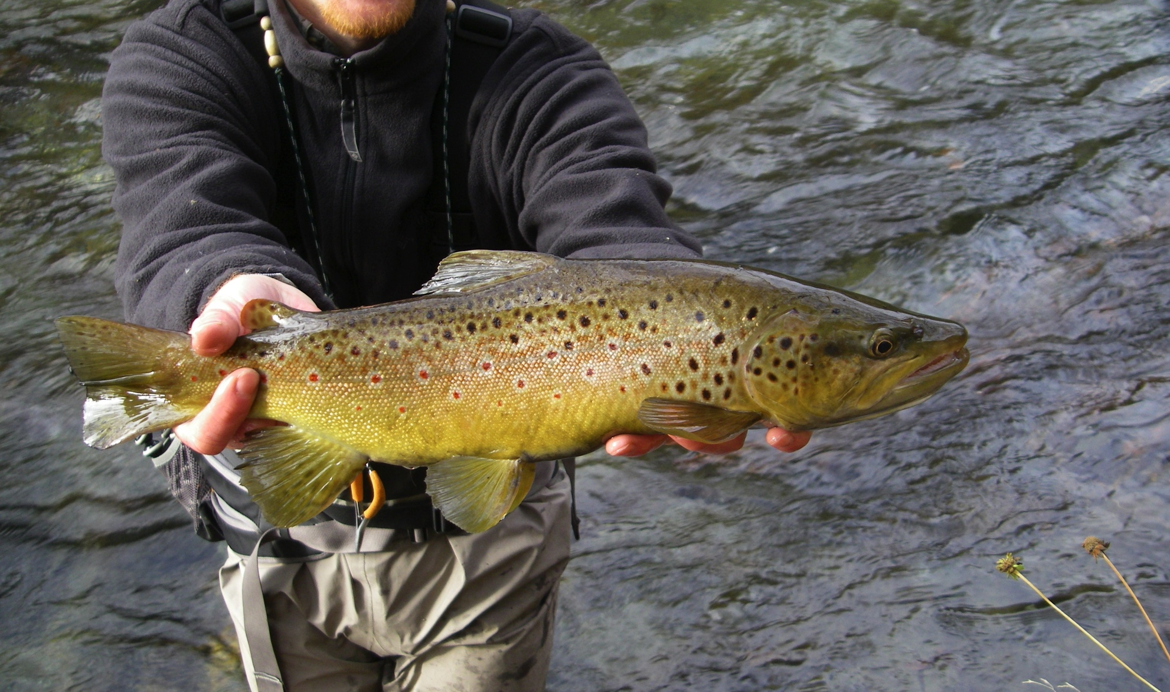
Streams: North Carolina

Slide 23
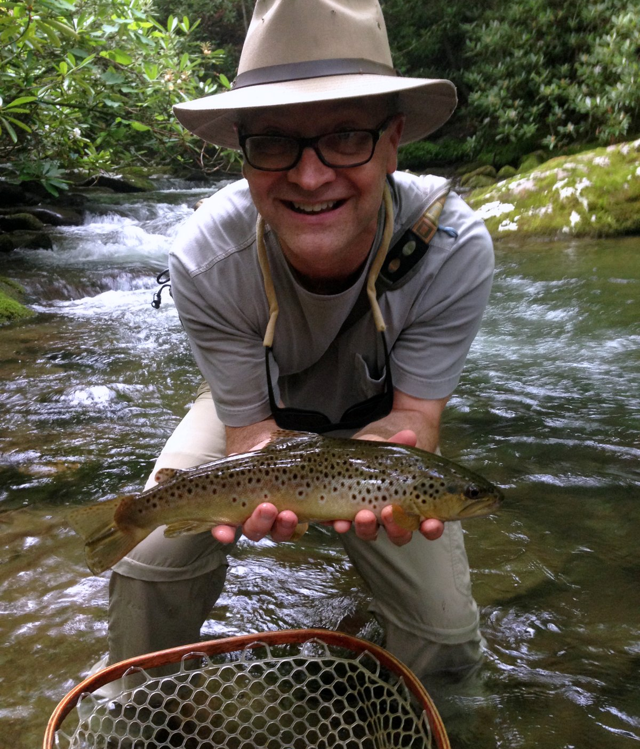
Streams: North Carolina
Brown trout are more widespread on the North Carolina side of the Park.

Slide 24
Streams: North Carolina
Cataloochee Valley is one of the most beautiful parts of the Park but also one of the most difficult to reach. The easiest way is over a gravel road from near Maggie Valley, NC. The draw in Cataloochee is the elk herd that has been reestablished there.
Locals fish the area a fair amount but there is a lot of unpressured water that probably has not seen a fisherman for at least several days and likely several weeks.
If you are in the area, don’t overlook the tributaries like Caldwell Fork, Palmer Creek, and Rough Fork. Browns are fairly widespread. Rainbows are the dominant fish and brook trout can be found as far down as the lower end of the valley and become more prevalent further upstream.

Slide 25
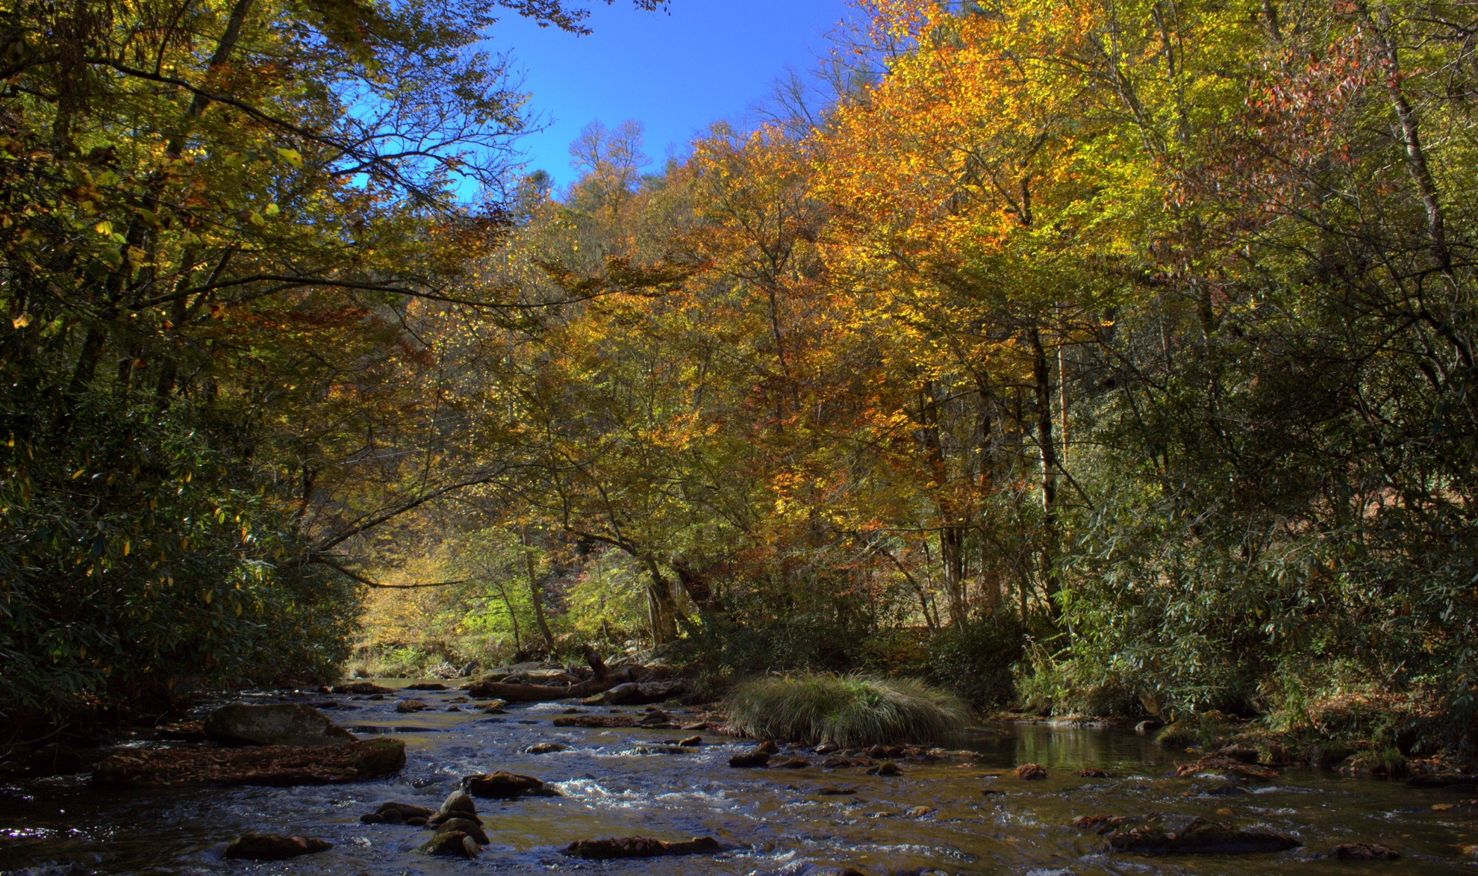
Streams: North Carolina

Slide 26
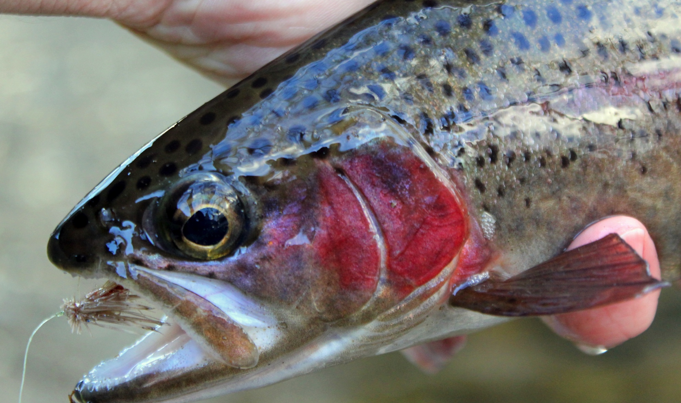
Streams: North Carolina

Slide 27
Streams: North Carolina
Big Creek is another remote stream but access is easier than at Cataloochee as it lies only about 2 miles off of I-40 near the North Carolina/Tennessee state line. It features a few browns that can be found as high as the Midnight Hole, 2 miles upstream from the trailhead as well as the usual rainbows. For those willing to hike, brookies will be found much further upstream.

Slide 28
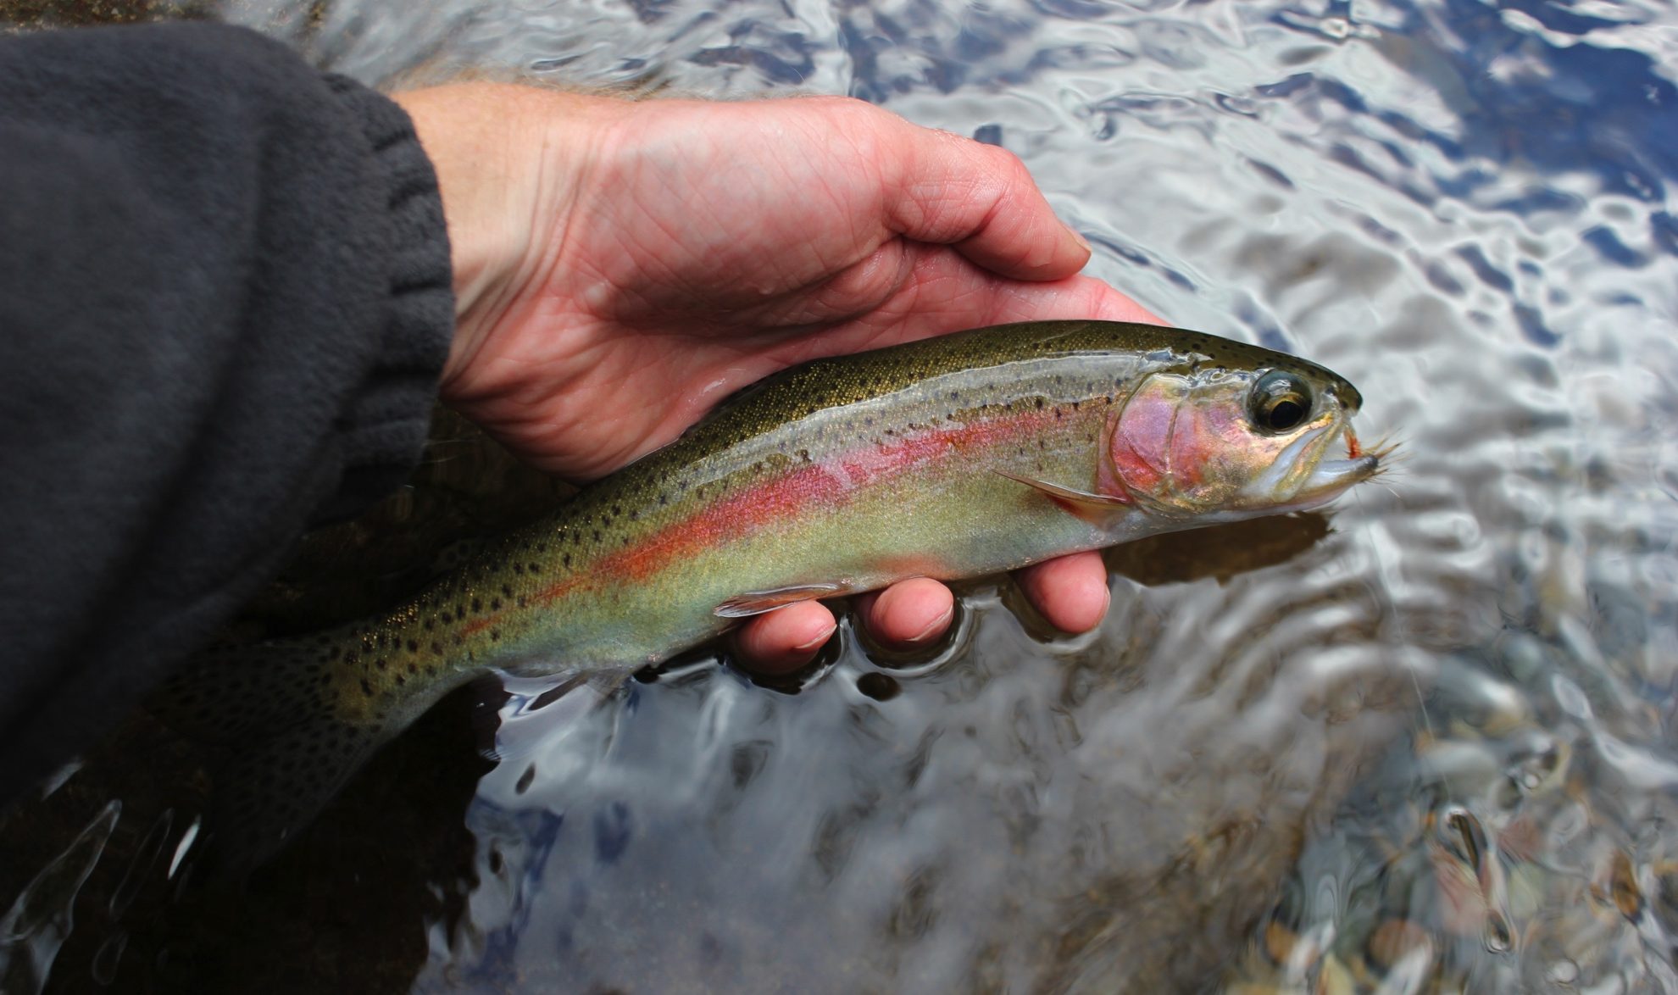
Streams: North Carolina

Slide 29
The Seasons and Hatches
Winter – Fewest anglers out on the water. Fishing tends to be slower than the warmer months but there are noticeable exceptions to this. Great time to catch a big fish if you are willing to put in a LOT of time to do so.
  Hatches: Midges #16-#26, Blue-winged Olives #16-#22, winter stoneflies (Little Black #16-#18 and Early Brown Stones #12-#14), and the odd caddis are all possible. Your best fishing will usually come on a two fly rig with a large stonefly nymph trailed by a small mayfly nymph or midge.

Slide 30
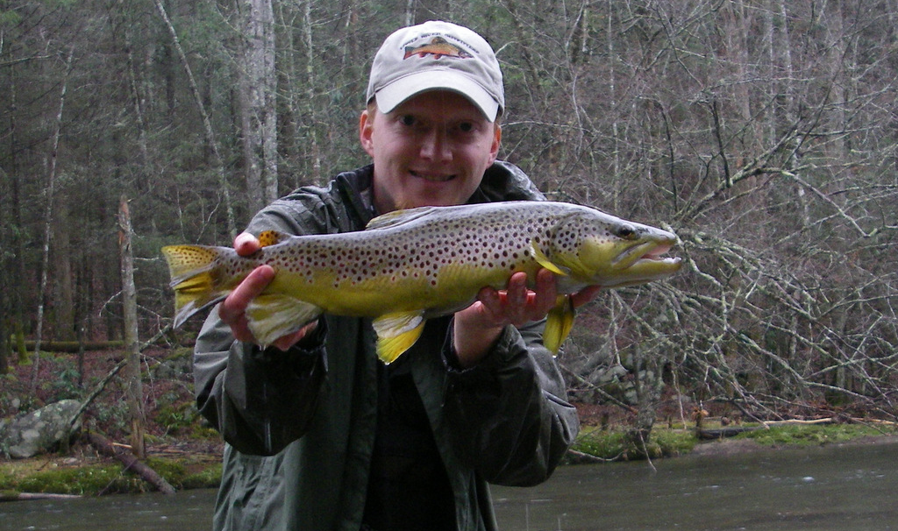
The Seasons and Hatches

Slide 31
The Seasons and Hatches
Spring – First good hatches of the year start in early spring and the fish go on a feeding binge. Due to highly variable weather, the fishing is inconsistent unfortunately, but if you hit it right, you will have some of the best dry fly fishing of the year with large fish possible on dries.
  Hatches: Little Black Caddis #16-#18, Early Brown Stones #12-#14, Blue-winged Olives #16-#20, Blue Quills #16-#20, Quill Gordons #10-#14, Hendricksons #12-#14, March Browns #10-#12, Little Yellow Stoneflies (Little Yellow Sallies) #14-#16, Light Cahills #14-#16, Pale Evening Duns #14-#16, Sulfurs #16-#18, Golden Stoneflies #6-#12, Slate Drakes (Isonychia) #10-#12, various caddis #14-#18, terrestrials such as ants #12-#22 and inchworms (#12-#16).

Slide 32
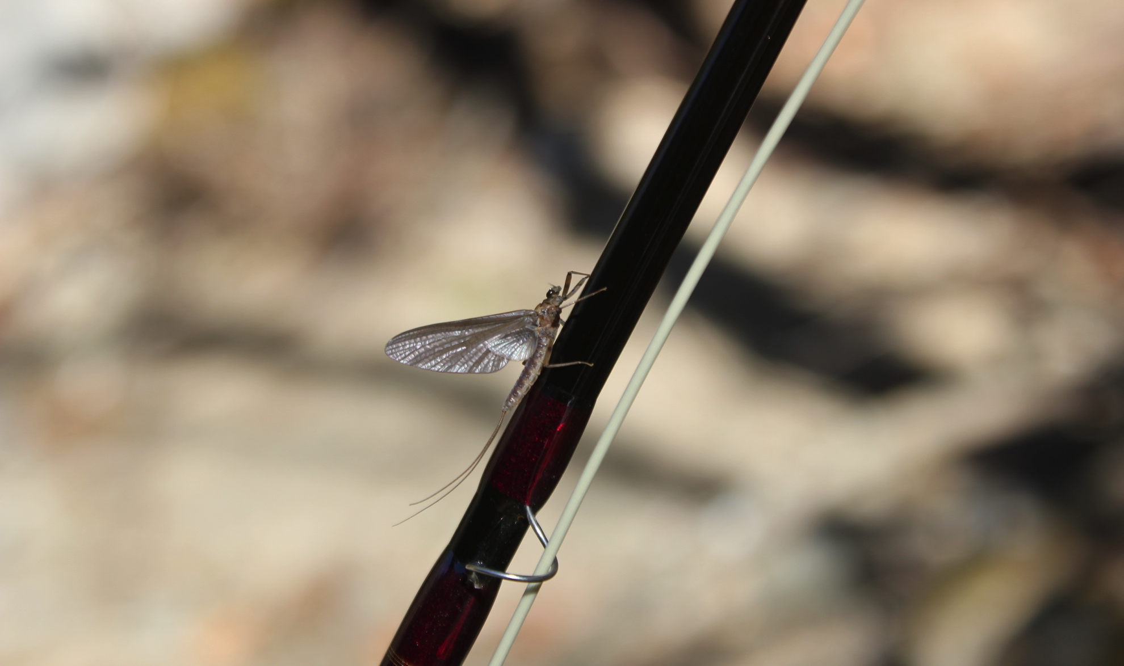
The Seasons and Hatches

Slide 33
The Seasons and Hatches
Summer – The fishing settles into a steady routine featuring the hatches from late spring, some of which will trickle off until the first frost in October if not later. Terrestrials dominate although there can still be good hatches. High elevation brook trout water is fishing very well as long as it doesn’t get too dry. By late summer, streams get low and the fishing gets tough. Stealth becomes as important as it will be all year.
  Hatches: Little Yellow Stoneflies (Little Yellow Sallies) #14-#18, Cream Cahills #14-#16, Light Cahills #14-#16, Pale Evening Duns #14-#16, Sulfurs #16-#18, Golden Stoneflies #6-#12, Slate Drakes (Isonychia) #10-#12, Mahogany Duns #18, Little Yellow Quills #16, various caddis #14-#18, terrestrials such as beetles #10-#14, ants #12-#20, bees/yellow jackets #10-#14, and inchworms #12-#16.

Slide 34
The Seasons and Hatches
Fall – My favorite season but just barely. This is mostly because of the fall colors and fish that will rise to dry flies well again after a long hot summer. Low water and spooky fish are the norm so you usually need to bring your best game.
  Hatches: Slate Drakes (Isonychia) #10-#12, Mahogany Duns #18, Little Yellow Quills #16, Great Brown Autumn Sedge (October Caddis) #10-#12, Blue-winged Olives #16-#22, various caddis #14-#18, terrestrials such as beetles #10-#14, ants #12-#20, bees/yellow jackets #10-#14, and inchworms #12-#16.

Slide 35
The Seasons and Hatches
Streamer “Hatch”
  Streamers are an overlooked method in the Smokies. Consider dead drifting a weighted wooly bugger or other streamer. Fall through spring is time to fish streamers actively. You are not going to catch a lot of fish, but you are looking for that one big fish that is in the mood to eat a streamer. Match streamers to the natural prey available to the big browns: small rainbow and brown trout, sculpins, and crawdads.

Slide 36
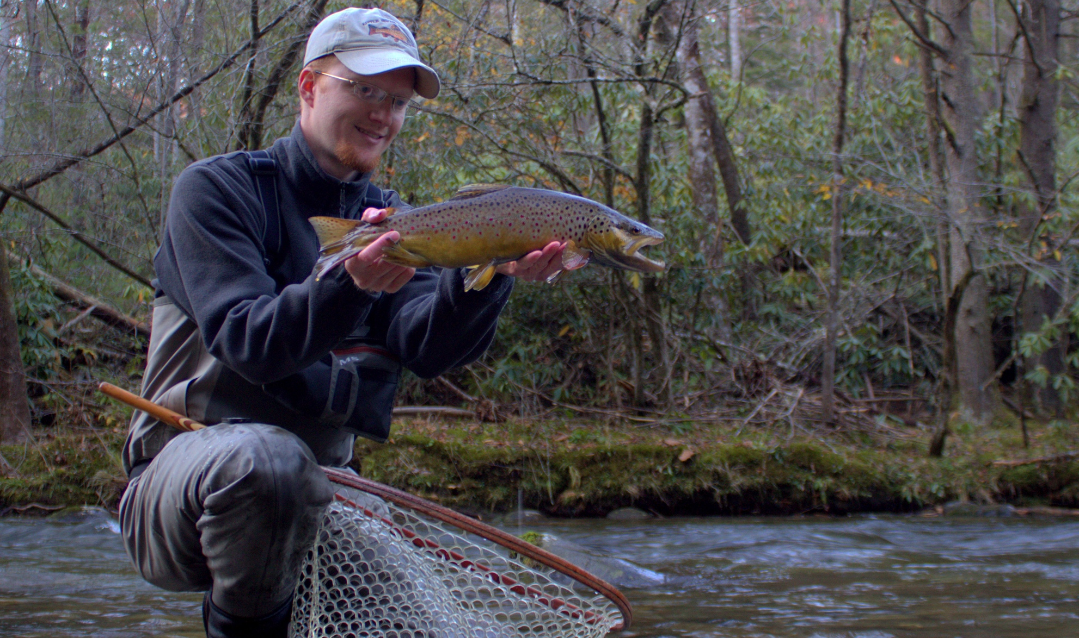
The Seasons and Hatches

Slide 37
Tips for Success
Terrestrials are going to catch a LOT of fish, especially ants but also beetles and inchworms (Green Weenie). Ants will usually be best fished sunken.
Slate Drakes/Isonychias will get the attention of some good fish, but only the nymphs are important.
During the spring hatches, drop a weighted (bead head) caddis pupa behind your favorite dry.
For streamers, bigger is NOT always better. Keep them mostly small and natural. Dead drift is often the best method.
Fish will be near current seams.

Slide 38
Tips for Success
Get in shape NOW. The farther you walk the better the fishing, sort of.
More accurately, the harder to get to the water the better the fishing. This leaves some surprisingly accessible water that doesn’t get fished as much as you would think.
Learn to highstick.
Less is more. Don’t try to throw your whole line. More often than not I have 2 feet of fly line out plus my leader.
Don’t come expecting big fish which is not the same as coming specifically to look for big fish.
To catch big fish, you have to pay your dues.

Slide 39
Tips for Success
Get out there and explore! Most of my favorite spots are ones I found on my own by exploring.
Fish with a buddy for safety.
Learn to fish nymphs effectively if you don’t already.
Wear camo or drab colored clothes.

Slide 40
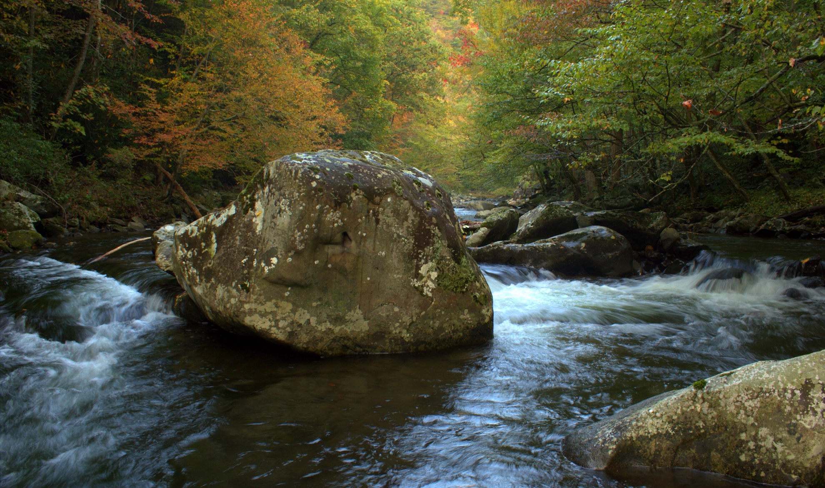
Questions?

